Slide 1


Unit 4

Slide 2

x
i
y
i
Carry-in
c
i
Sum
s
i
Carry-out
c
i
+1
At the i^{th} stage:
Input:
c_{i} is the carry-in
Output:
s_{i} is the sum
c_{i+1} carry-out to (i+1)^{st}
state
0
0
0
0
0
0
0
1
1
0
0
1
0
1
0
0
1
1
0
1
1
0
0
1
0
1
0
1
0
1
1
1
0
0
1
1
1
1
1
1
s
i
=
x
i
y
i
c
i
+
x
i
y
i
c
i
+
x
i
y
i
c
i
+
x
i
y
i
c
i
=
x
i
⊕
y
i
⊕
c
i
c
=
y
i
c
i
+
x
i
c
i
+
x
i
y
i
i
+1
E
xample:
X
7
0
1
1
1
Carry-out
x
i
Carry-in
+
Y
=
+ 6
=
+
0
0
1
1
1
1
0
0
0
c
y
i
c
Z
13
1
1
0
1
i
+1
s
i
i
Legend for stage
i

Slide 3

Sum
Carry
y
i
c
i
x
i
y
s
x
i
c
i
i
c
i
i
+
1
c
i
x
x
i
y
i
y
i
i
c
i
+
1
Full adder
c
i
(F
A)
s
i
Full Adder (FA): Symbol for the complete circuit
for a single stage of addition.

Slide 4

Cascade n full adder (FA) blocks to form a n-bit adder.
Carries propagate or ripple through this cascade, n-bit ripple carry adder.
x
n
-
1
y
n
-
1
x
1
y
1
x
0
y
0
c
n
-
1
c
1
c
n
F
A
F
A
F
A
c
0
s
n
-
1
s
1
s
0
Most significant bit
Least significant bit
(MSB) position
(LSB) position
Carry-in c₀ into the LSB position provides a convenient way to
perform subtraction.

Slide 5

K n-bit numbers can be added by cascading k n-bit adders.
x
k
n
-
1
y
k
n
-
1
x
2
n
-
1
y
2
n
-
1
x
n
y
n
x
n
-
1
y
n
-
1
x
0
y
0
n
-
bit
n
-
bit
c
n
n
-
bit
c
k
n
adder
adder
adder
c
0
s
k
n
-
1
s
(
k
-
1
)
n
s
2
n
-
1
s
n
s
n
-
1
s
0
Each n-bit adder forms a block, so this is cascading of blocks.
Carries ripple or propagate through blocks, Blocked Ripple Carry Adder

Slide 6

Recall X – Y is equivalent to adding 2’s complement of Y to X.
2’s complement is equivalent to 1’s complement + 1.
X – Y = X + Y + 1
2’s complement of positive and negative numbers is computed similarly.
x
n
-
1
y
n
-
1
x
1
y
1
x
0
y
0
c
n
-
1
c
1
c
n
F
A
F
A
F
A
1
s
n
-
1
s
1
s
0
Most significant bit
Least significant bit
(MSB) position
(LSB) position

Slide 7

y
n
-
1
y
1
y
0
Add/Sub
control
x
n
-
1
x
1
x
0
c
n
-bit adder
n
c
0
s
n
-
1
s
1
s
0
Add/sub control = 0, addition.
Add/sub control = 1, subtraction.

Slide 8


Detecting overflows
Overflows can only occur when the sign of the two operands is the same.
Overflow occurs if the sign of the result is different from the sign of the operands.
Recall that the MSB represents the sign.
  x_{n-1}, y_{n-1}, s_{n-1} represent the sign of operand x, operand y and result s respectively.
Circuit to detect overflow can be implemented by the following logic expressions:

Slide 9

x₀
y₀
Consider 0th stage:
c₁ is available after 2 gate delays.
s₁ is available after 1 gate delay.
c₁
FA
c₀
s₀
Sum
Carry
y
i
c
i
x
i
y
s
x
i
c
i
i
c
i
i
+
1
c
i
x
y
i
i

Slide 10

Cascade of 4 Full Adders, or a 4-bit adder
x₀
y₀
x₀
y₀
x₀
y₀
x₀
y₀
FA
FA
FA
c₁
FA
c₀
c₄
c₃
c₂
s₃
s₂
s₁
s₀
s₀ available after 1 gate delays, c₁ available after 2 gate delays.
s₁ available after 3 gate delays, c₂ available after 4 gate delays.
s₂ available after 5 gate delays, c₃ available after 6 gate delays.
s₃ available after 7 gate delays, c₄ available after 8 gate delays.
For an n-bit adder, s_{n-1} is available after 2n-1 gate delays
c_{n} is available after 2n gate delays.

Slide 11

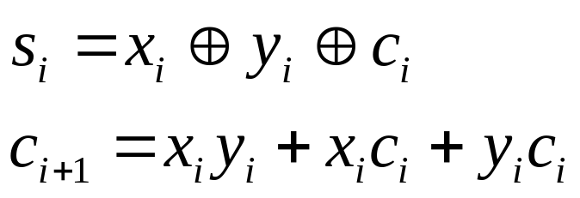
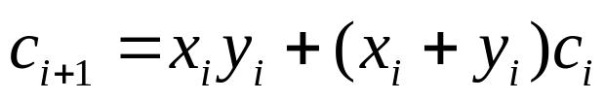
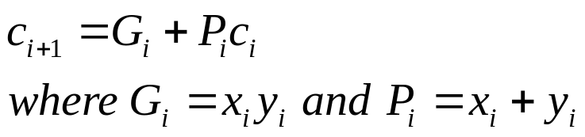
Recall the equations:
Second equation can be written as:
We can write:
G_{i} is called generate function and P_{i} is called propagate function
G_{i} and P_{i} are computed only from x_{i} and y_{i} and not c_{i}, thus they can
be computed in one gate delay after X and Y are applied to the
inputs of an n-bit adder.

Slide 12

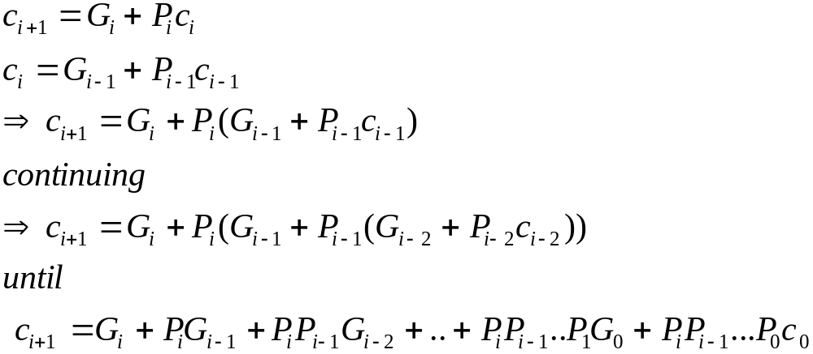
All carries can be obtained 3 gate delays after X, Y and c₀ are applied.
-One gate delay for P_{i} and G_{i}
-Two gate delays in the AND-OR circuit for c_{i+1}
All sums can be obtained 1 gate delay after the carries are computed.
Independent of n, n-bit addition requires only 4 gate delays.
This is called Carry Lookahead adder.

Slide 13

x
3
y
3
x
2
y
2
x
1
y
1
x
0
y
0
.
4-bit
carry-lookahead
adder
c
c
3
c
2
c
1
c
4
B cell
B cell
B cell
B cell
0
s
3
s
2
s
1
s
0
G
3
P
3
G
2
P
2
G
1
P
1
G
0
P
0
Carry-lookahead logic
x
i
y
i
.
.
.
c
i
B-cell for a single stage
B cell
G
i
P
i
s
i

Slide 14
Carry lookahead adder (contd..)
Performing n-bit addition in 4 gate delays independent of n is good only theoretically because of fan-in constraints.
Last AND gate and OR gate require a fan-in of (n+1) for a n-bit adder.
  For a 4-bit adder (n=4) fan-in of 5 is required.
  Practical limit for most gates.
In order to add operands longer than 4 bits, we can cascade 4-bit Carry-Lookahead adders. Cascade of Carry-Lookahead adders is called Blocked Carry-Lookahead adder.
c
=
G
+
P
G
+
P
P
G
+
..
+
P
P
..
P
G
+
P
P
...
P
c₀
i
+
1
i
i
i
−
1
i
i
−
1
i
−
2
i
i
−
1
1
0
i
i
−
1
0

Slide 15

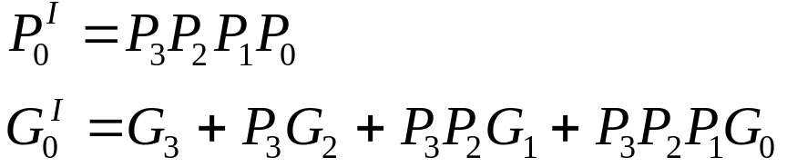
Carry-out from a 4-bit block can be given as:
Rewrite this as:
Subscript I denotes the blocked carry lookahead and identifies the block.
Cascade 4 4-bit adders, c₁₆ can be expressed as:

Slide 16
x
15-12
y
15-12
x
11-8
y
11-8
x
7-4
y
7-4
x
3-0
y
3-0
.
c
12
c
8
c
4
c
16
4-bit adder
4-bit adder
4-bit adder
4-bit adder
c
0
s
15-12
s
11-8
s
7-4
s
3-0
G
3
I
P
3
I
G
2
I
P
2
I
G
1
I
P
1
I
G
0
I
P
0
I
Carry-lookahead logic
After x_{i}, y_{i} and c₀ are applied as inputs:
- G_{i} and P_{i} for each stage are available after 1 gate delay.
- P^{I} is available after 2 and G^{I} after 3 gate delays.
- All carries are available after 5 gate delays.
- c₁₆ is available after 5 gate delays.
- s₁₅ which depends on c₁₂ is available after 8 (5+3)gate delays
(Recall that for a 4-bit carry lookahead adder, the last sum bit is
available 3 gate delays after all inputs are available)

Slide 17


Slide 18

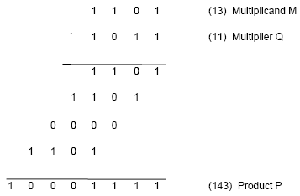
Product of 2 n-bit numbers is at most a 2n-bit number.
Unsigned multiplication can be viewed as addition of shifted
versions of the multiplicand.

Slide 19
Multiplication of unsigned numbers (contd..)
We added the partial products at end.
  Alternative would be to add the partial products at each stage.
Rules to implement multiplication are:
  If the i^{th} bit of the multiplier is 1, shift the multiplicand and add the shifted multiplicand to the current value of the partial product.
  Hand over the partial product to the next stage
  Value of the partial product at the start stage is 0.

Slide 20

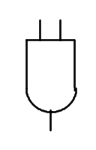
Typical multiplication cell
Bit of incoming partial product (PPi)
j^{th} multiplicand bit
i^{th} multiplier bit
i^{th} multiplier bit
carry out
FA
carry in
Bit of outgoing partial product (PP(i+1))

Slide 21

Combinatorial array multiplier
Multiplicand
(PP0)
0
m
3
0
m
2
0
m
1
0
m
0
q
0
PP1
0
q
p
0
0
1
PP2
p
Multiplier
q
2
1
0
PP3
p
2
q
3
0
p
p
p
p
p
,
7
6
5
4
3
Product is: p₇,p₆,..p₀
Multiplicand is shifted by displacing it through an array of adders.

Slide 22
Combinatorial array multiplier (contd..)
Combinatorial array multipliers are:
  Extremely inefficient.
  Have a high gate count for multiplying numbers of practical size such as 32-bit or 64-bit numbers.
  Perform only one function, namely, unsigned integer product.
Improve gate efficiency by using a mixture of combinatorial array techniques and sequential techniques requiring less combinational logic.

Slide 23
Sequential multiplication
Recall the rule for generating partial products:
  If the ith bit of the multiplier is 1, add the appropriately shifted multiplicand to the current partial product.
  Multiplicand has been shifted left when added to the partial product.
However, adding a left-shifted multiplicand to an unshifted partial product is equivalent to adding an unshifted multiplicand to a right-shifted partial product.

Slide 24

Register A (initially 0)
Shift right
C
a
a
q
q
n
-
1
0
n
-
1
0
Multiplier Q
Add/Noadd
control
n-bit
Adder
MUX
Control
sequencer
0
0
m
n
-
1
m
0
Multiplicand M

Slide 25

M
1 1 0 1
Initial configuration
0
0 0 0 0
1 0 1 1
C
A
Q
0
1 1 0 1
1 0 1 1
Add
First cycle
0
0 1 1 0
1 1 0 1
Shift
1
0 0 1 1
1 1 0 1
Add
Second cycle
0
1 0 0 1
1 1 1 0
Shift
0
1 0 0 1
1 1 1 0
No add
Third cycle
0
0 1 0 0
1 1 1 1
Shift
1
0 0 0 1
1 1 1 1
Add
0
1 0 0 0
1 1 1 1
Shift
Fourth cycle
Product

Slide 26


Slide 27
Signed Multiplication
Considering 2’s-complement signed operands, what will happen to (-13)×(+11) if following the same method of unsigned multiplication?
1
0
0
1
1
(
-
13
)
0
1
0
1
1
(
+
11
)
1
1
1
1
1
1
0
0
1
1
1
1
1
1
1
0
0
1
1
Sign extension is
0
0
0
0
0
0
0
0
shown in blue
1
1
1
0
0
1
1
0
0
0
0
0
0
1
1
0
1
1
1
0
0
0
1
(
-
143
)
Sign extension of negative multiplicand.

Slide 28
Signed Multiplication
For a negative multiplier, a straightforward solution is to form the 2’s-complement of both the multiplier and the multiplicand and proceed as in the case of a positive multiplier.
This is possible because complementation of both operands does not change the value or the sign of the product.
A technique that works equally well for both negative and positive multipliers – Booth algorithm.

Slide 29
Booth Algorithm
Consider in a multiplication, the multiplier is positive 0011110, how many appropriately shifted versions of the multiplicand are added in a standard procedure?
0
1
0
1
1
0
1
0
0
+
1
+
1
+
1
+
1
0
0
0
0
0
0
0
0
0
1
0
1
1
0
1
0
1
0
1
1
0
1
0
1
0
1
1
0
1
0
1
0
1
1
0
1
0
0
0
0
0
0
0
0
0
0
0
0
0
0
0
0
0
1
0
1
0
1
0
0
0
1
1
0

Slide 30
Booth Algorithm
Since 0011110 = 0100000 – 0000010, if we use the expression to the right, what will happen?
0
1
0
1
1
0
1
0
+
1
0
0
0
-
1
0
0
0
0
0
0
0
0
0
0
0
0
0
0
0
2's complement of
1
1
1
1
1
1
1
0
1
0
0
1
1
the multiplicand
0
0
0
0
0
0
0
0
0
0
0
0
0
0
0
0
0
0
0
0
0
0
0
0
0
0
0
0
0
0
0
0
0
0
0
0
1
0
1
1
0
1
0
0
0
0
0
0
0
0
0
0
0
1
0
1
0
1
0
0
0
1
1
0

Slide 31
Booth Algorithm
In general, in the Booth scheme, -1 times the shifted multiplicand is selected when moving from 0 to 1, and +1 times the shifted multiplicand is selected when moving from 1 to 0, as the multiplier is scanned from right to left.
0
0
1
0
1
1
0
0
1
1
1
0
1
0
1
1
0
0
0
+
1
-
1
+
1
0
-
1
0
+
1
0
0
-
1
+
1
-
1
+
1
0
-
1
0
0
Booth recoding of a multiplier.

Slide 32
Booth Algorithm
Multiplier
V
ersion of multiplicand
selected by bit
i
Bit
i
Bit
i
-
1
0
0
0
X
M
0
1
+
1
X
M
1
0
−
1
X
M
1
1
0
X
M
Booth multiplier recoding table.

Slide 33
Booth Algorithm
Best case – a long string of 1’s (skipping over 1s)
Worst case – 0’s and 1’s are alternating
0
1
0
1
0
1
0
1
0
1
0
1
0
1
0
1
Worst-case
multiplier
-
+
1
-
1
+
1
-
1
+
1
-
1
+
1
-
1
+
1
-
1
+
1
-
1
+
1
-
1
+
1
1
1
1
0
0
0
1
0
1
1
0
1
1
1
1
0
0
Ordinary
multiplier
0
-
1
0
0
+
1
-
1
+
1
0
-
1
+
1
0
0
0
-
1
0
0
0
0
0
0
1
1
1
1
1
0
0
0
0
1
1
1
Good
multiplier
0
0
0
+
1
0
0
0
0
-
1
0
0
0
+
1
0
0
-
1

Slide 34
Booth Algorithm
0
1
1
0
1
(
+
13
)
0
1
1
0
1
X
1
1
0
1
0
(
-
6
)
0
-
1
+1
-
1
0
0
0
0
0
0
0
0
0
0
0
1
1
1
1
1
0
0
1
1
0
0
0
0
1
1
0
1
1
1
1
0
0
1
1
0
0
0
0
0
0
1
1
1
0
1
1
0
0
1
0
(
-
78
)
Booth multiplication with a negative multiplier.

Slide 35


Slide 36
Bit-Pair Recoding of Multipliers
Bit-pair recoding halves the maximum number of summands (versions of the multiplicand).
Sign extension
Implied 0 to right of LSB
1
1
1
0
1
0
0
0
0
−
1
+
1
−
1
0
0
−
1
−
2
(a) Example of bit-pair recoding derived from Booth recoding

Slide 37
Bit-Pair Recoding of Multipliers
Multiplier bit-pair
Multiplier bit on the right
Multiplicand
i
+
1
i
i
−
1
selected at position
i
0
0
0
0
X M
0
0
1
+
1
X M
0
1
0
+
1
X M
0
1
1
+
2
X M
1
0
0
−
2
X M
1
0
1
−
1
X M
1
1
0
−
1
X M
1
1
1
0
X M
(b) Table of multiplicand selection decisions

Slide 38
Bit-Pair Recoding of Multipliers
0
1
1
0
1
0
-
1
+
1
-
1
0
0
0
0
0
0
0
0
0
0
0
1
1
1
1
1
0
0
1
1
0
0
0
0
1
1
0
1
1
1
1
0
0
1
1
0
1
1
0
1
(
+
13
)
0
0
0
0
0
0
×
1
1
0
1
0
(
-
6
)
1
1
1
0
1
1
0
0
1
0
(
-
78
)
0
1
1
0
1
0
-
1
-
2
1
1
1
1
1
0
0
1
1
0
1
1
1
1
0
0
1
1
0
0
0
0
0
0
1
1
1
0
1
1
0
0
1
0
Figure 6.15. Multiplication requiring only n/2 summands.

Slide 39
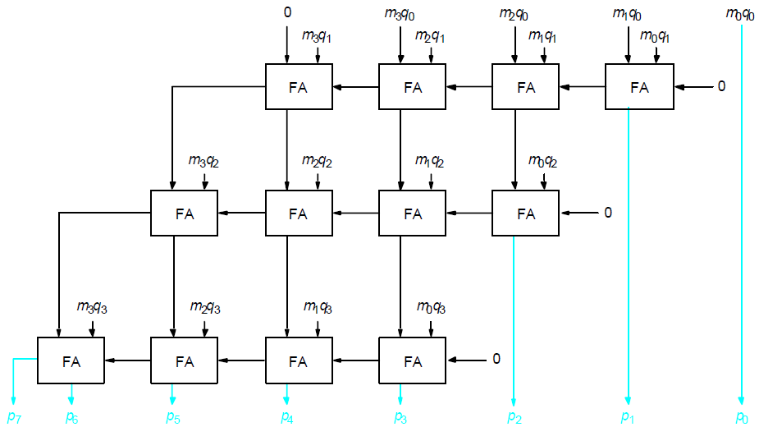
Carry-Save Addition of Summands
CSA speeds up the addition process.
P7
P6
P5
P4
P3
P2
P1
P0

Slide 40
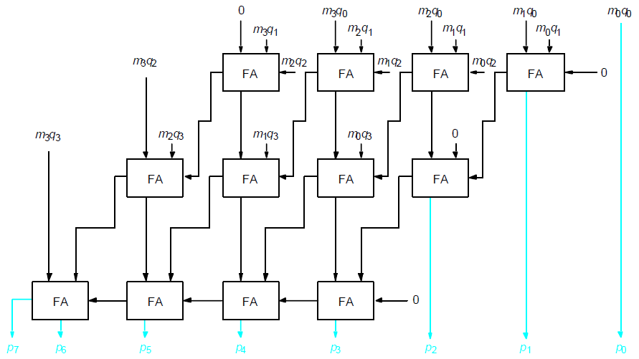
Carry-Save Addition of Summands(Cont.,)
P7
P6
P5
P4
P3
P2
P1
P0

Slide 41
Carry-Save Addition of Summands(Cont.,)
Consider the addition of many summands, we can:
Group the summands in threes and perform carry-save addition on each of these groups in parallel to generate a set of S and C vectors in one full-adder delay
Group all of the S and C vectors into threes, and perform carry-save addition on them, generating a further set of S and C vectors in one more full-adder delay
Continue with this process until there are only two vectors remaining
They can be added in a RCA or CLA to produce the desired product

Slide 42
Carry-Save Addition of Summands
1
0
1
1
0
1
(45)
M
X
1
1
1
1
1
1
(63)
Q
1
0
1
1
0
1
A
1
0
1
1
0
1
B
1
0
1
1
0
1
C
1
0
1
1
0
1
D
1
0
1
1
0
1
E
1
0
1
1
0
1
F
1
0
1
1
0
0
0
1
0
0
1
1
(2,835)
Product
Figure 6.17. A multiplication example used to illustrate carry-save addition as shown in Figure 6.18.

Slide 43
1
0
1
1
0
1
M
x
1
1
1
1
1
1
Q
1
0
1
1
0
1
A
1
0
1
1
0
1
B
1
0
1
1
0
1
C
1
1
0
0
0
0
1
1
S
1
0
0
1
1
1
1
0
0
C
1
1
0
1
1
0
1
D
1
0
1
1
0
1
E
1
0
1
1
0
1
F
1
1
0
0
0
0
1
1
S
2
0
0
1
1
1
1
0
0
C
2
1
1
0
0
0
0
1
1
S
1
0
0
1
1
1
1
0
0
C
1
1
1
0
0
0
0
1
1
S
2
1
1
0
1
0
1
0
0
0
1
1
S
3
0
0
0
0
1
0
1
1
0
0
0
C
3
0
0
1
1
1
1
0
0
C
2
0
1
0
1
1
1
0
1
0
0
1
1
S
4
+
0
1
0
1
0
1
0
0
0
0
0
C
4
1
0
1
1
0
0
0
1
0
0
1
1
Product
Figure 6.18. The multiplication example from Figure 6.17 performed using
carry-save addition.

Slide 44


Slide 45
Manual Division
13
21
1101
10101
274
100010010
26
1101
14
10000
13
1101
1
1110
1101
1
Longhand division examples.

Slide 46
Longhand Division Steps
Position the divisor appropriately with respect to the dividend and performs a subtraction.
If the remainder is zero or positive, a quotient bit of 1 is determined, remainder is extended by another bit of the dividend, the divisor is repositioned, and another subtraction is performed.
If the remainder is negative, a quotient bit of 0 is determined, the dividend is restored by adding back the divisor, and the divisor is repositioned for another subtraction.

Slide 47
Circuit Arrangement
Shift left
a_{n}
a_{n-1}
a₀
q_{n-1}
q₀
Dividend Q
A
Quotient
Setting
N+1 bit
adder
Add/Subtract
Control
Sequencer
0
m_{n-1}
m₀
Divisor M
Figure 6.21. Circuit arrangement for binary division.

Slide 48
Restoring Division
Shift A and Q left one binary position
Subtract M from A, and place the answer back in A
If the sign of A is 1, set q₀ to 0 and add M back to A (restore A); otherwise, set q₀ to 1
Repeat these steps n times

Slide 49
Examples
Initially
0
0
0
0
0
1
0
0
0
0
0
0
1
1
Shift
0
0
0
0
1
0
0
0
Subtract
1
1
1
0
1
First cycle
Set
q
0
1
1
1
1
0
Restore
1
1
1
0
0
0
0
0
1
0
0
0
0
Shift
0
0
0
1
0
0
0
0
1
1
1
0
0
0
Subtract
1
1
1
0
1
1
1
Set
q
0
1
1
1
1
1
Second cycle
Restore
1
1
1
1
0
0
0
0
1
0
0
0
0
0
Shift
0
0
1
0
0
0
0
0
Subtract
1
1
1
0
1
Set
q
0
0
0
0
0
1
Third cycle
Shift
0
0
0
1
0
0
0
0
1
Subtract
1
1
1
0
1
0
0
1
Set
q
0
1
1
1
1
1
Fourth cycle
Restore
1
1
0
0
0
1
0
0
0
1
0
Remainder
Quotient
Figure 6.22. A restoring-division example.

Slide 50
Nonrestoring Division
Avoid the need for restoring A after an unsuccessful subtraction.
Any idea?
Step 1: (Repeat n times)
If the sign of A is 0, shift A and Q left one bit position and subtract M from A; otherwise, shift A and Q left and add M to A.
Now, if the sign of A is 0, set q₀ to 1; otherwise, set q₀ to 0.
Step2: If the sign of A is 1, add M to A

Slide 51
Examples
Initially
0
0
0
0
0
1
0
0
0
0
0
0
1
1
Shift
0
0
0
0
1
0
0
0
First cycle
Subtract
1
1
1
0
1
Set
q
0
1
1
1
1
0
0
0
0
0
Shift
1
1
1
0
0
0
0
0
Add
0
0
0
1
1
Second cycle
Set
q
0
1
1
1
1
1
0
0
0
0
Shift
1
1
1
1
0
0
0
0
1
1
1
1
1
Restore
remainder
Add
0
0
0
1
1
Third cycle
0
0
0
1
1
Set
q
0
0
0
0
0
1
0
0
0
1
Add
0
0
0
1
0
Remainder
Shift
0
0
0
1
0
0
0
1
Subtract
1
1
1
0
1
Fourth cycle
Set
q
0
1
1
1
1
1
0
0
1
0
A nonrestoring-division example.
Quotient

